Slide 1

Lecture 2
Row Echelon Form

Slide 2

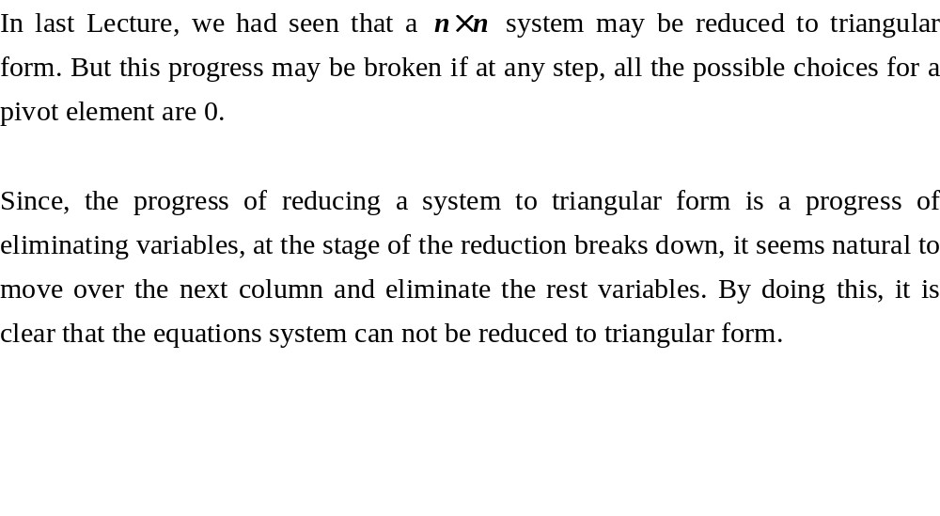
Row Echelon Form

Slide 3
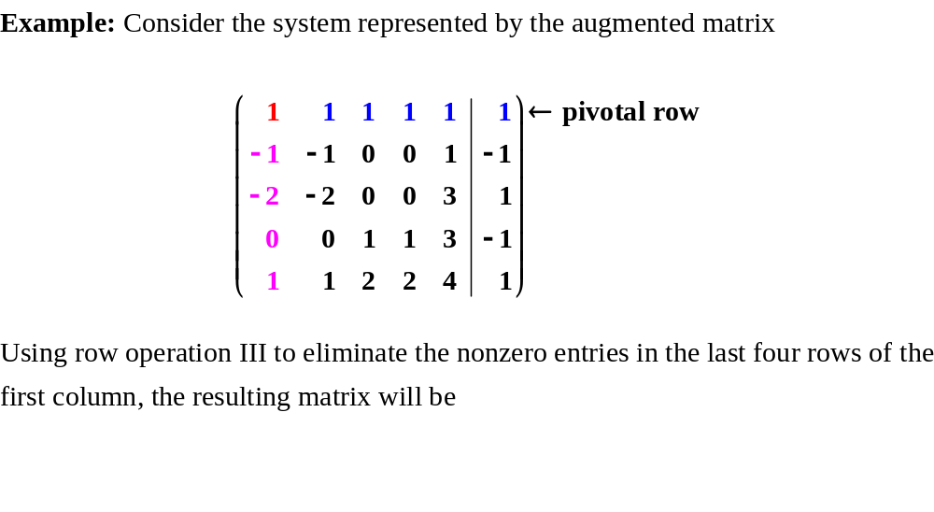
Row Echelon Form

Slide 4
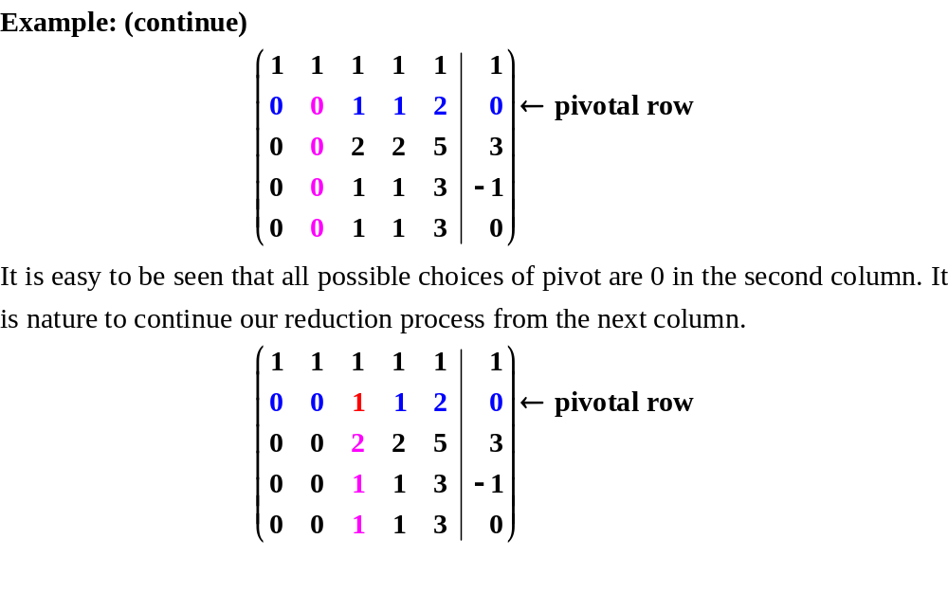
Row Echelon Form

Slide 5
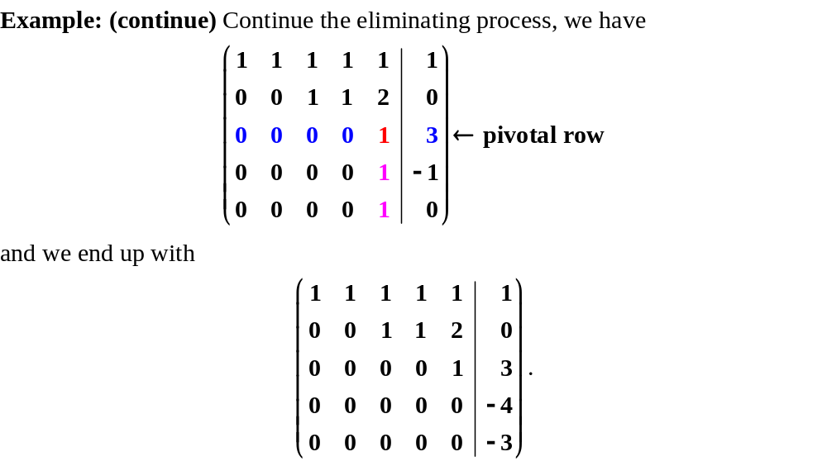
Row Echelon Form

Slide 6
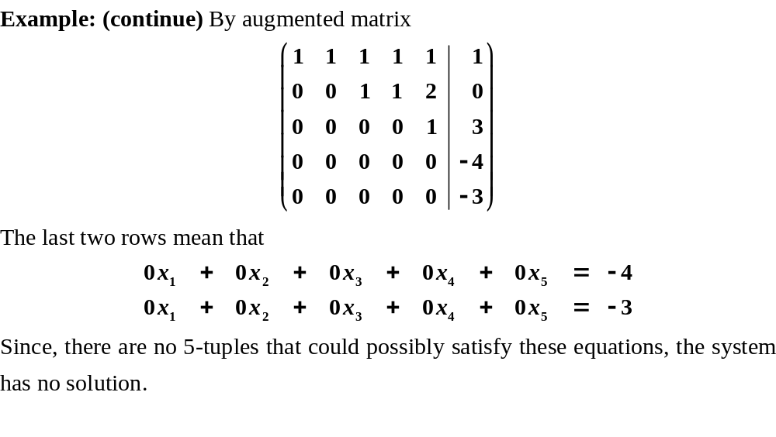
Row Echelon Form

Slide 7
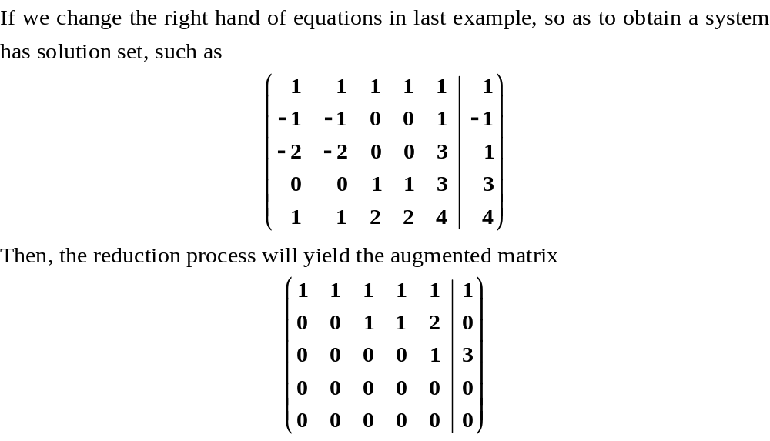
Row Echelon Form
Will be satisfied for any
5-tuple.

Slide 8
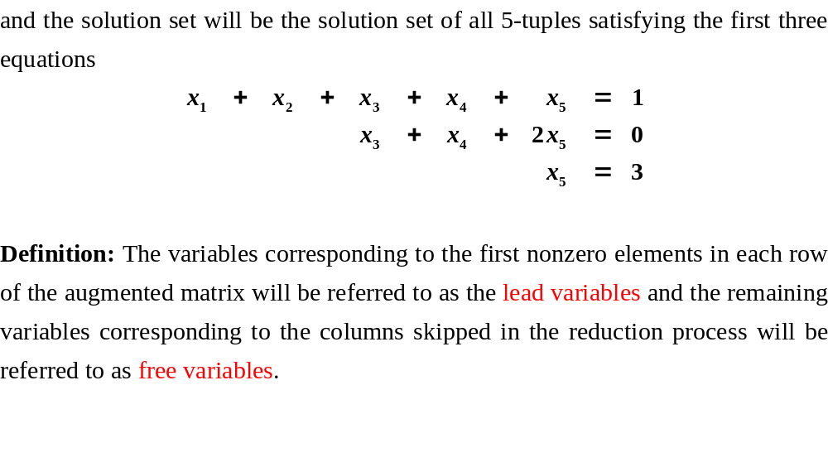
Row Echelon Form

Slide 9
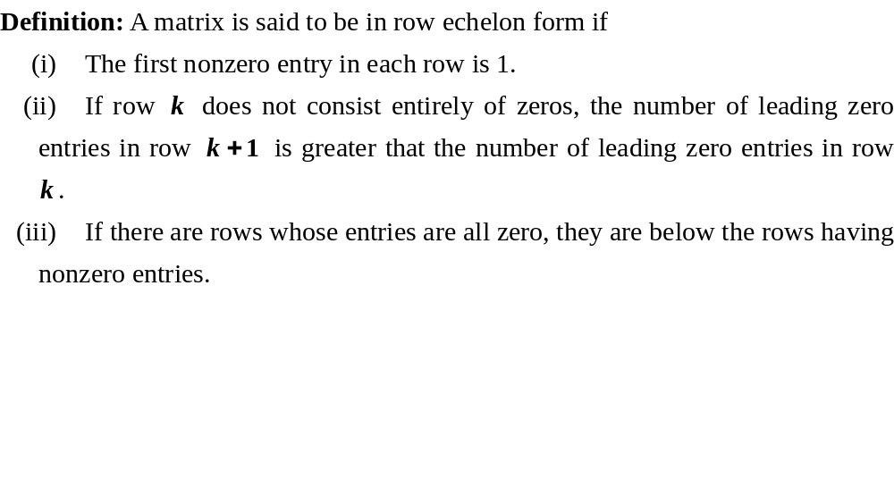
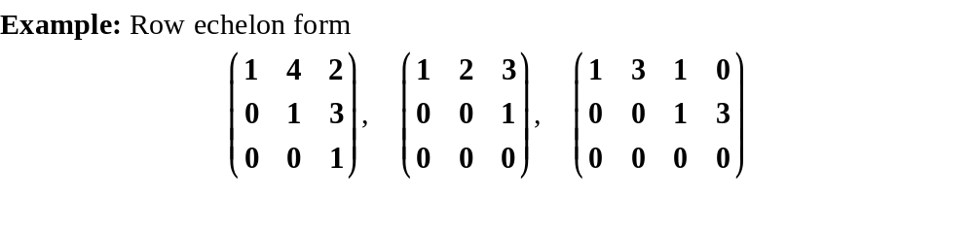
Row Echelon Form

Slide 10
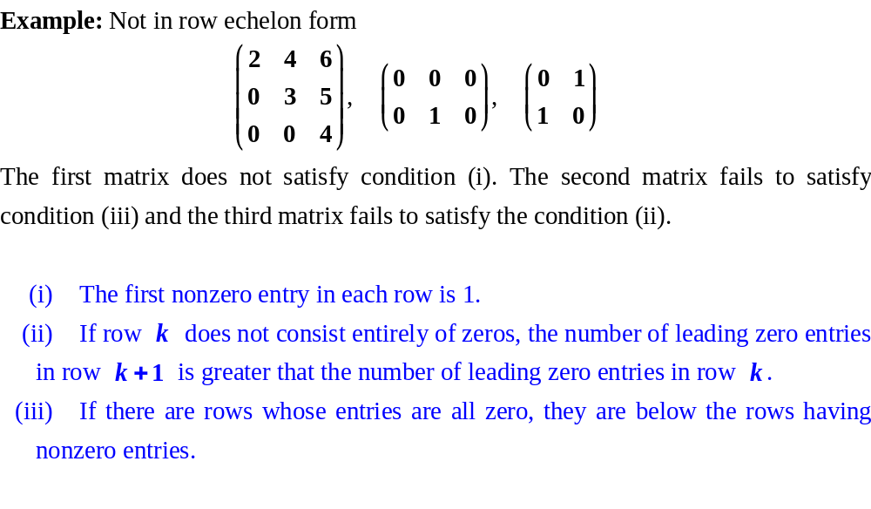
Row Echelon Form

Slide 11
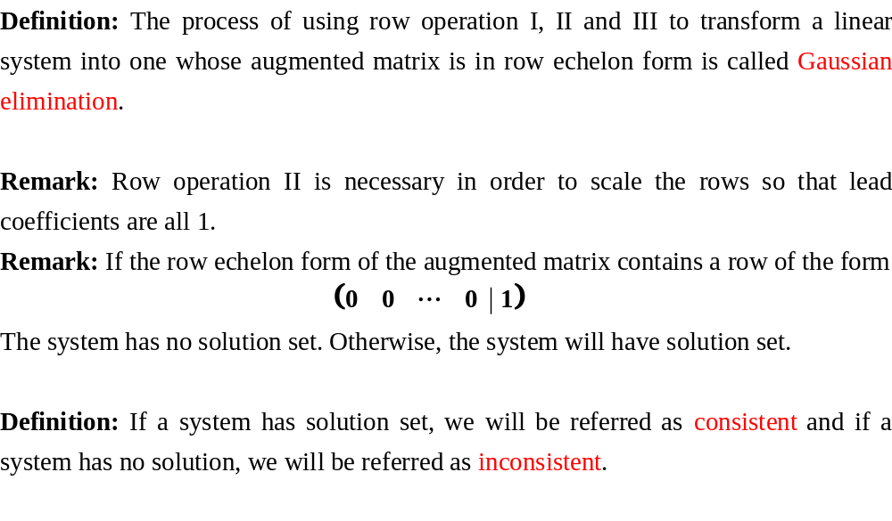
Row Echelon Form

Slide 12
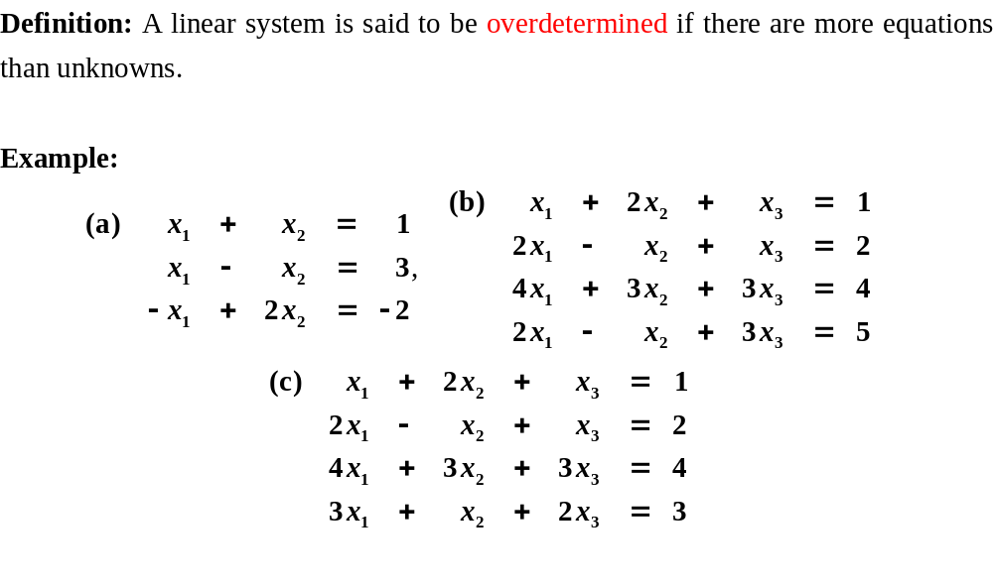
Overdetermined Systems

Slide 13
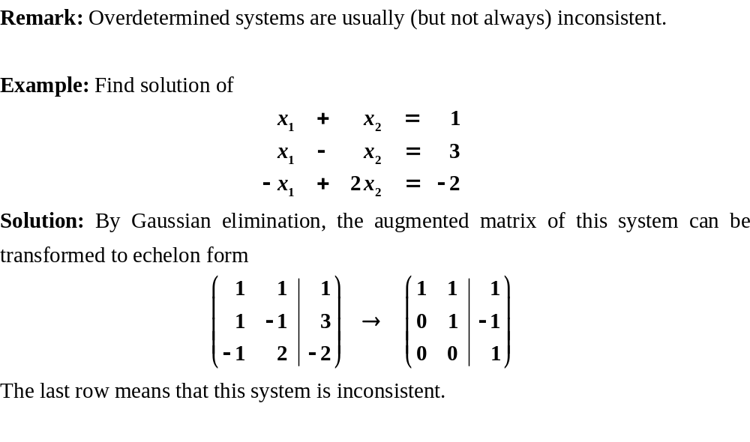




Overdetermined Systems

Slide 14
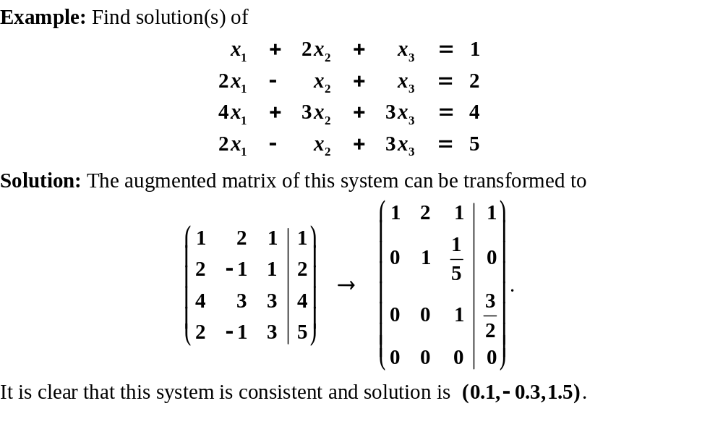
Overdetermined Systems

Slide 15
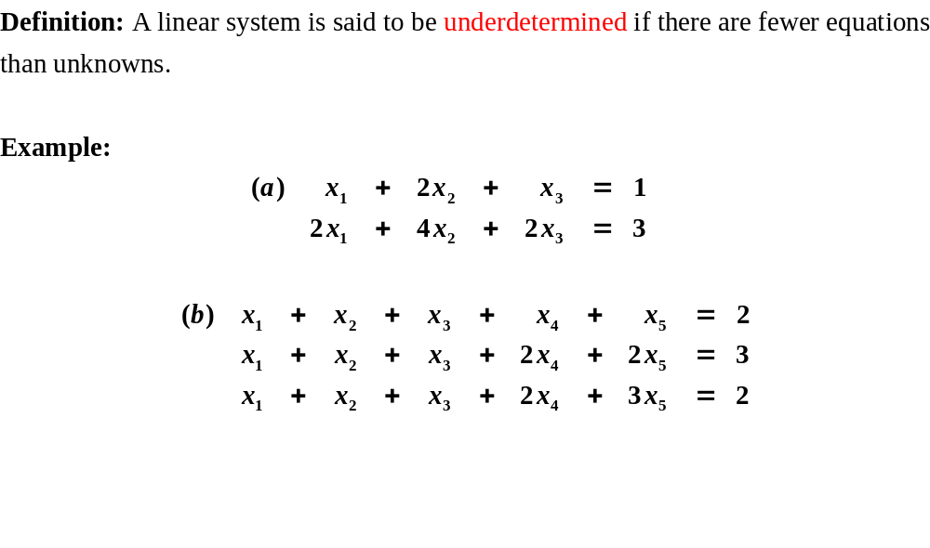
Underdetermined Systems

Slide 16
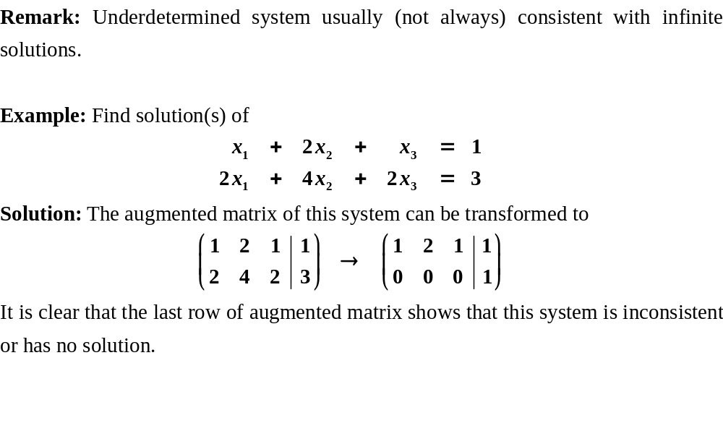
Underdetermined Systems

Slide 17
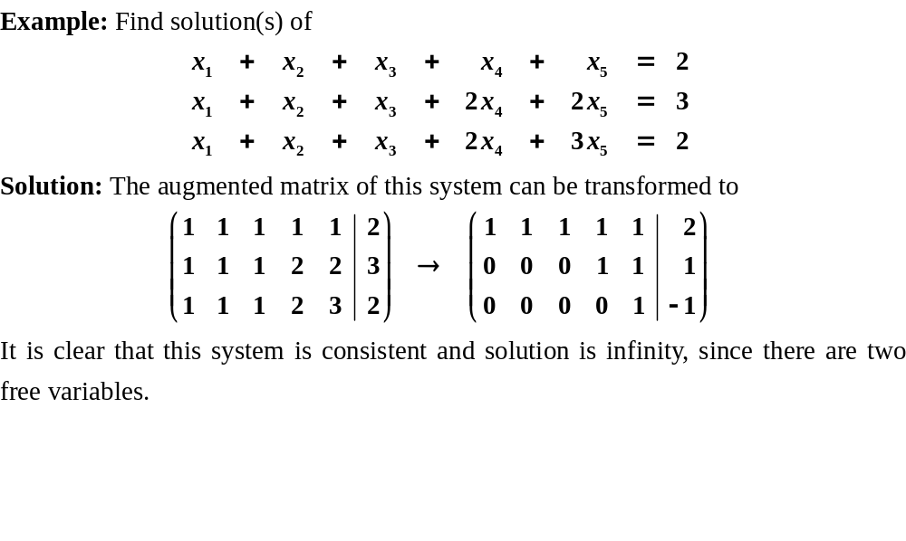
Underdetermined Systems

Slide 18
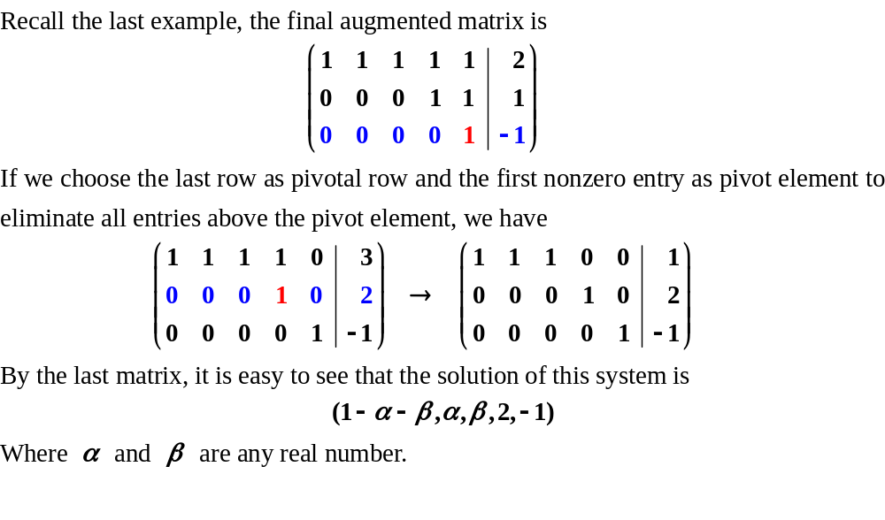
Reduced Row Echelon Form

Slide 19
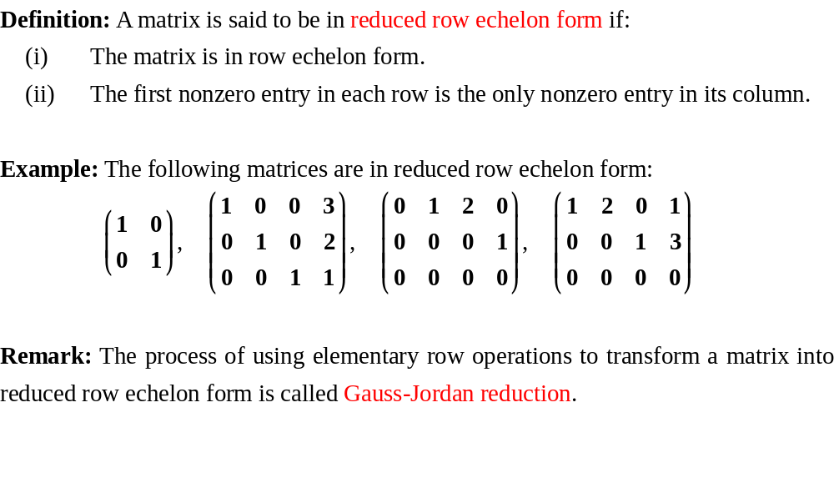
Reduced Row Echelon Form

Slide 20
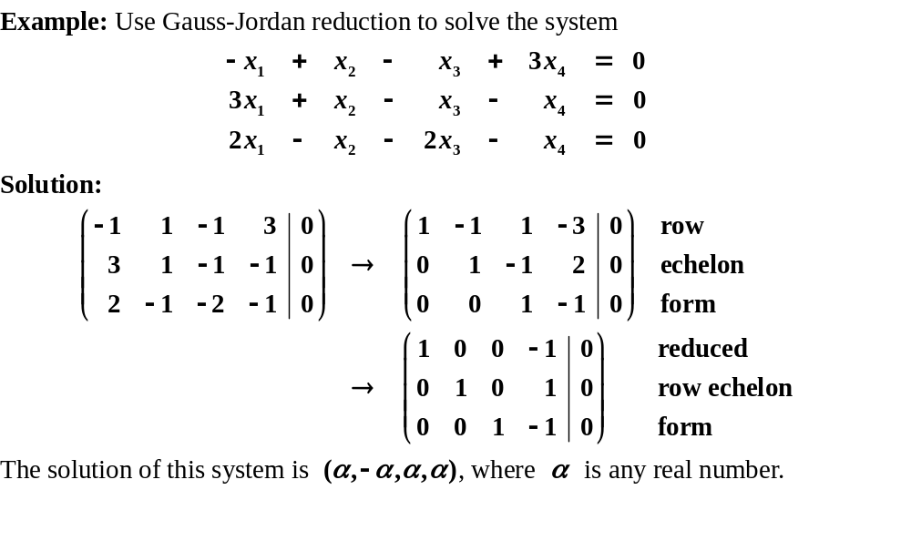
Reduced Row Echelon Form

Slide 21














Application I: Traffic Flow

Slide 22
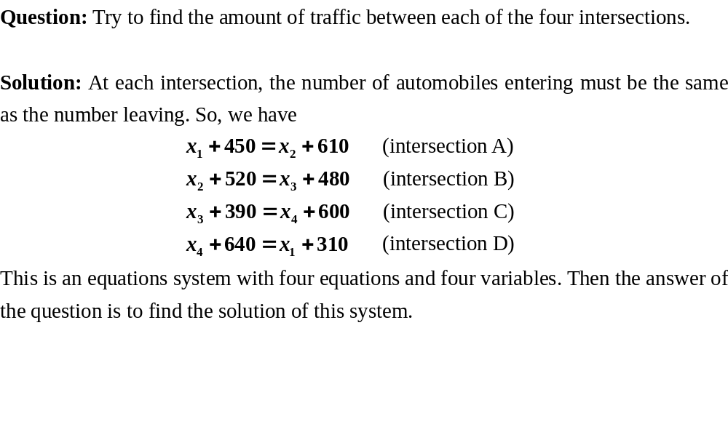
Application I: Traffic Flow

Slide 23
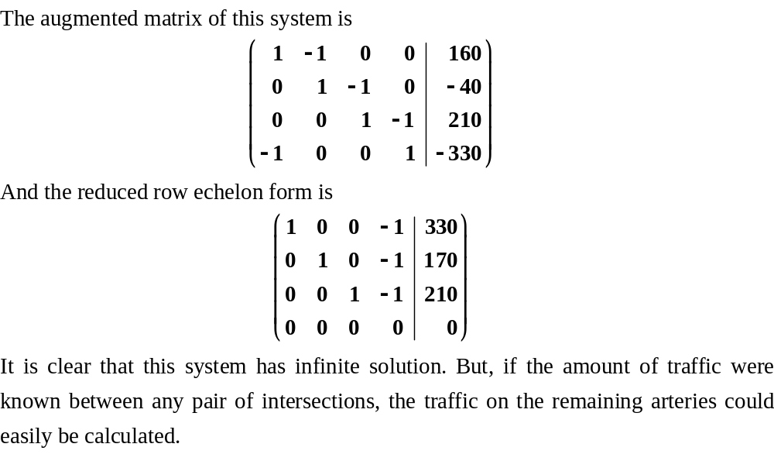
Application I: Traffic Flow

Slide 24
Application II: Electrical networks
It is a reading material. Read it and try to solve it by yourself.

Slide 25
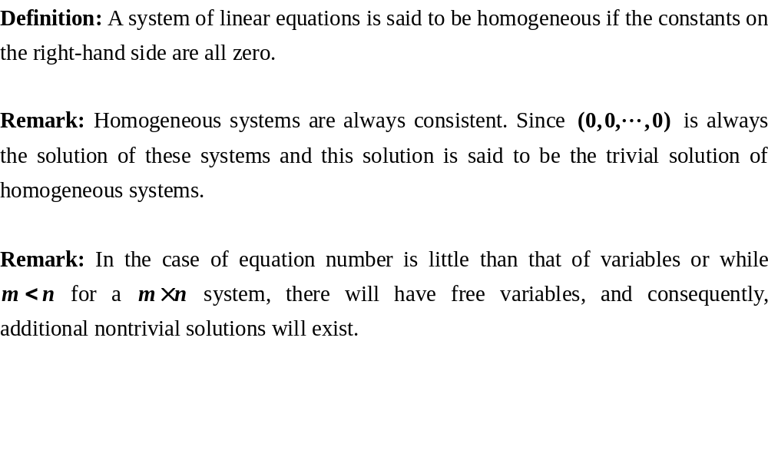
Homogeneous System

Slide 26
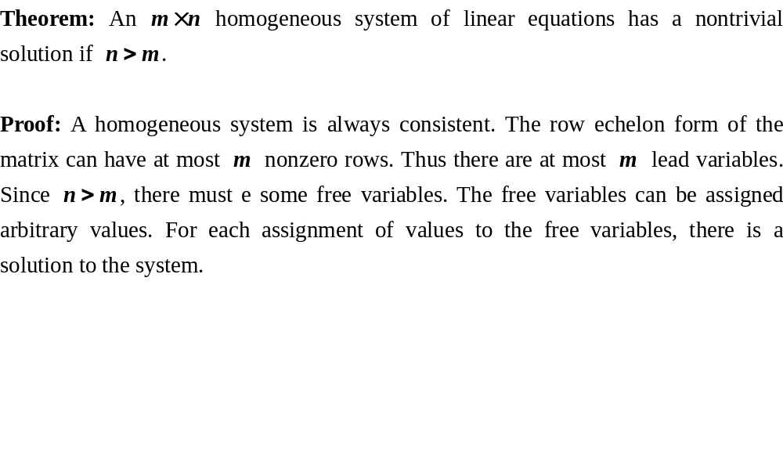
Homogeneous System

Slide 27
Exercises
P28/1,2,3,6(a)(c),7,13
Preview
Matrix algebra

